Slide 1
Group: What happens if the lattice is not rectangular?
Determine the reciprocal lattice for:
a₂
b₂
a₁
b₁
Real space
Fourier (reciprocal) space
In 2D, reciprocal vectors are perpendicular to opposite axis.

Slide 2
The reciprocal lattice in one dimension
a
Real lattice
x
-π/a
π/a
What is the range of unique environments?
Reciprocal lattice
k
-6π/a
-4π/a
-2π/a
0
2π/a
4π/a
Does this look familiar to anything?
Weigner Seitz Cell: Smallest space enclosed when intersecting the midpoint to the neighboring lattice points.
Why don’t we include second neighbors here (do in 2D/3D)?

Slide 3
The Brillouin Zone (BZ)
-π/a
π/a
Reciprocal lattice
k
-6π/a
-4π/a
-2π/a
0
2π/a
4π/a
Is defined as the Wigner-Seitz primitive cell in the reciprocal lattice (smallest unique set of distance/area/volume in reciprocal space)
Its construction exhibits all the wavevectors k which can be Bragg-reflected by the crystal
Also critical for understanding energy diagrams
Notes:
Got here in 50 minute class, XRD pattern took some time

Slide 4
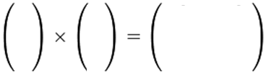
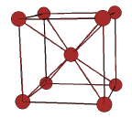




Group: Find the reciprocal lattice vectors of BCC
A
B
C
D
E
F
B F – E C
D C – A F
A E – B C
The primitive lattice vectors for BCC are:
The volume of the primitive cell is ½ a³(2 pts./unit cell)
So, the primitive translation vectors in reciprocal space are:
Look familiar?
Good websites:
http://newton.umsl.edu/run//nano/reltutor2.html
http://matter.org.uk/diffraction/geometry/plane_reciprocal_lattices.htm
Notes:
These lattice vectors should look familiar.

Slide 5
Reciprocal Lattices to SC, FCC and BCC
Primitive Direct lattice Reciprocal lattice Volume of BZ
SC
BCC
FCC
Direct | Reciprocal
Simple cubic | Simple cubic
bcc | fcc
fcc | bcc
Notes:
Got here (slide 19) in talkative class. Spend a lot of time talking about Perovskites to review basic crystal structure concepts.
If we took b1 dot (b2 cross b3) we’d get the volume of the reciprocal cell, which would give these. Might come back and prove these values if time at the end of class.
Makes sense since real space volume was smaller for FCC in real space, so bigger in reciprocal space.

Slide 6
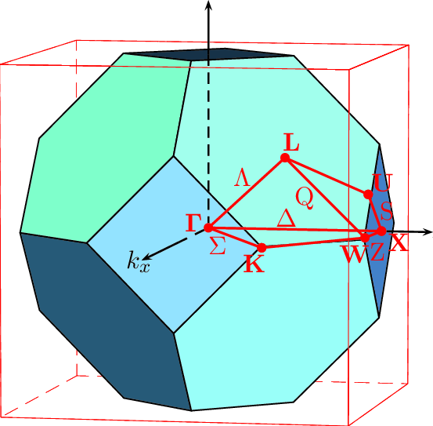
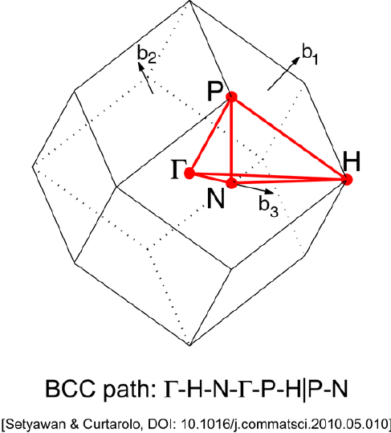
Wigner-Seitz cells and Brillouin Zones
What type of crystal is the BZ cutout?
The reciprocal lattice of BCC if FCC, so the BZ of bcc looks like FCC and vice versa.
Notes:
We did this in real space before. But to get the BZ we need the reciprocal lattice.
Which type of crystal is the cut out? It looks like the BCC Wigner-Seitz cell, which means it’s the BZ for an fcc crystal. So, diamond, Si, even things with more than one atom in the basis but are the fcc lattice like NaCl and GaAs.
If we had more time before the next homework, I’d have you cut these out to visualize them more, but other things are more important. Feel free to cut them out on your own.

Slide 7
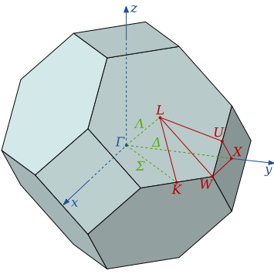
Nomenclature
Usually, it is sufficient to know the energy E_{n}(k) curves - the dispersion relations - along the major directions.
Directions are chosen that lead aong special symmetry points. These points are labeled according to the following rules:
Points (and lines) inside the Brillouin zone are denoted with Greek letters.
Points on the surface of the Brillouin zone with Roman letters.
The center of the Wigner-Seitz cell is always denoted by a Γ
Notes:
Remember that directions in reciprocal space refer to planes of atoms in real space.

Slide 8
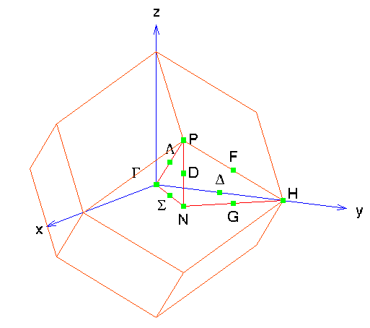
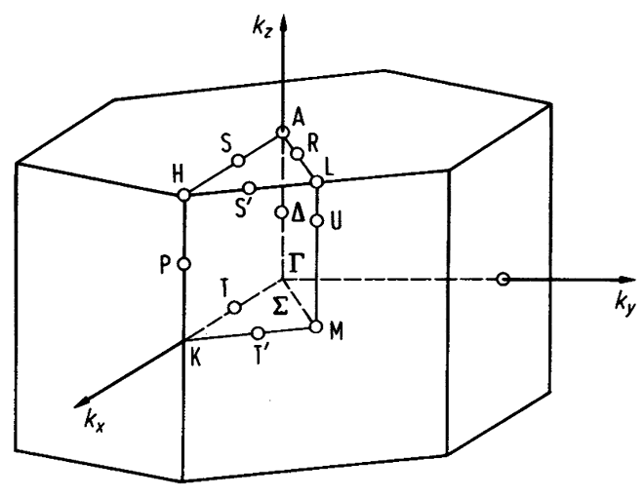
Brillouin Zones in 3D
fcc
bcc
Note: bcc lattice in reciprocal space is a fcc lattice
hcp
Note: fcc lattice in reciprocal space is a bcc lattice
Construction leads to primitive unit cell in rec. space
The BZ reflects lattice symmetry (some argue that most of solid state physics can be understood by understanding symmetry)

Slide 9
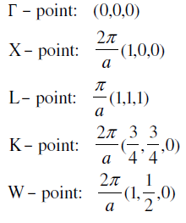
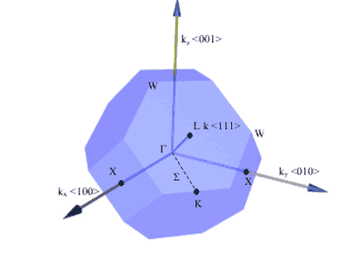
Brillouin Zone of Silicon
Symbol | Description
Γ | Center of the Brillouin zone
Simple Cubic
M | Center of an edge
R | Corner point
X | Center of a face
FCC
K | Middle of an edge joining two hexagonal faces
L | Center of a hexagonal face C₆
U | Middle of an edge joining a hexagonal and a square face
W | Corner point
X | Center of a square face C₄
BCC
H | Corner point joining 4 edges
N | Center of a face
P | Corner point joining 3 edges
Points of symmetry on the BZ are important (e.g. determining bandstructure).
Electrons in semiconductors are perturbed by the potential of the crystal, which varies across unit cell.
Notes:
For example, let’s look at silicon, a very important crystal for technology.

Slide 10
Now that we know how to construct reciprocal lattice vectors and BZs, let’s get back to how that helps us understand diffraction.

Slide 11
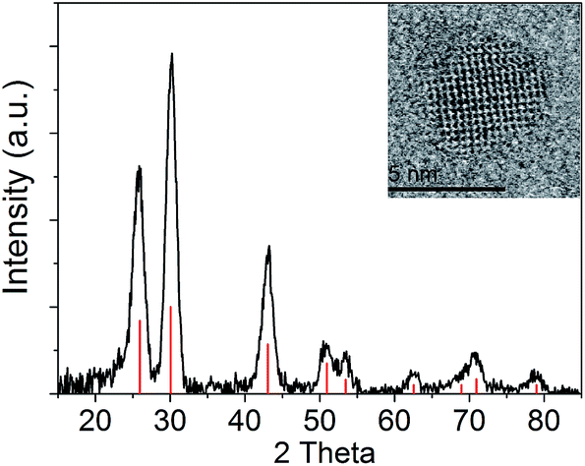
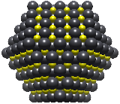
XRD allows Crystal Structure Determination
LATTICE TYPE
What do we need to know in order to define the crystal structure?
  The lattice parameters and the lattice type
PbS
Notes:
What other features from the XRD can give us information besides where are the peaks located. If need hint, if you were trying to model it with a series of gaussian functions, what parameters would you need? Position, width and intensity
Need to change K’s to G’s
After our diffraction topic you should be able to:
Calculate the structure factor for simple cubic, bcc, fcc, diamond, zinc blende, rock salt, cesium chloride
Diffraction pattern of a lead sulfide PbS quantum dot. Red bars are the expected peaks and intensities for rock salt structure, so great match.
Reference: http://pubs.rsc.org/en/content/articlehtml/2015/RA/C5RA13499D

Slide 12
XRD allows Crystal Structure Determination
POSITION OF PEAKS
LATTICE TYPE
What do we need to know in order to define the crystal structure?
  The lattice parameters and the lattice type
  (this defines the positions of diffraction spots)
PbS
Notes:
What other features from the XRD can give us information besides where are the peaks located. If need hint, if you were trying to model it with a series of gaussian functions, what parameters would you need? Position, width and intensity
Need to change K’s to G’s
After our diffraction topic you should be able to:
Calculate the structure factor for simple cubic, bcc, fcc, diamond, zinc blende, rock salt, cesium chloride
Diffraction pattern of a lead sulfide PbS quantum dot. Red bars are the expected peaks and intensities for rock salt structure, so great match.
Reference: http://pubs.rsc.org/en/content/articlehtml/2015/RA/C5RA13499D

Slide 13
XRD allows Crystal Structure Determination
POSITION OF PEAKS
LATTICE TYPE
WIDTH OF PEAK
INTENSITY OF PEAKS
What do we need to know in order to define the crystal structure?
  The lattice parameters and the lattice type
  (this defines the positions of diffraction spots)
PbS
Notes:
What other features from the XRD can give us information besides where are the peaks located. If need hint, if you were trying to model it with a series of gaussian functions, what parameters would you need? Position, width and intensity
Need to change K’s to G’s
After our diffraction topic you should be able to:
Calculate the structure factor for simple cubic, bcc, fcc, diamond, zinc blende, rock salt, cesium chloride
Diffraction pattern of a lead sulfide PbS quantum dot. Red bars are the expected peaks and intensities for rock salt structure, so great match.
Reference: http://pubs.rsc.org/en/content/articlehtml/2015/RA/C5RA13499D

Slide 14
XRD allows Crystal Structure Determination
POSITION OF PEAKS
LATTICE TYPE
WIDTH OF PEAK
PERFECTION OF LATTICE
INTENSITY OF PEAKS
What do we need to know in order to define the crystal structure?
  The lattice parameters and the lattice type
  (this defines the positions of diffraction spots)
PbS
Notes:
What other features from the XRD can give us information besides where are the peaks located. If need hint, if you were trying to model it with a series of gaussian functions, what parameters would you need? Position, width and intensity
Need to change K’s to G’s
After our diffraction topic you should be able to:
Calculate the structure factor for simple cubic, bcc, fcc, diamond, zinc blende, rock salt, cesium chloride
Diffraction pattern of a lead sulfide PbS quantum dot. Red bars are the expected peaks and intensities for rock salt structure, so great match.
Reference: http://pubs.rsc.org/en/content/articlehtml/2015/RA/C5RA13499D

Slide 15
XRD allows Crystal Structure Determination
POSITION OF PEAKS
LATTICE TYPE
WIDTH OF PEAK
PERFECTION OF LATTICE
INTENSITY OF PEAKS
POSITION OF ATOMS IN BASIS
What do we need to know in order to define the crystal structure?
  The lattice parameters and the lattice type
  (this defines the positions of diffraction spots)
  The atom type at each point
  (these define the intensity of diffraction spots)
PbS
Notes:
What other features from the XRD can give us information besides where are the peaks located. If need hint, if you were trying to model it with a series of gaussian functions, what parameters would you need? Position, width and intensity
Need to change K’s to G’s
After our diffraction topic you should be able to:
Calculate the structure factor for simple cubic, bcc, fcc, diamond, zinc blende, rock salt, cesium chloride
Diffraction pattern of a lead sulfide PbS quantum dot. Red bars are the expected peaks and intensities for rock salt structure, so great match.
Reference: http://pubs.rsc.org/en/content/articlehtml/2015/RA/C5RA13499D

Slide 16
XRD allows Crystal Structure Determination
POSITION OF PEAKS
LATTICE TYPE
WIDTH OF PEAK
PERFECTION OF LATTICE
INTENSITY OF PEAKS
POSITION OF ATOMS IN BASIS
What do we need to know in order to define the crystal structure?
  The lattice parameters and the lattice type
  (this defines the positions of diffraction spots)
  The atom type at each point
  (these define the intensity of diffraction spots)
  Conclusion: If we measure positions and intensities of many spots, then we should be able to determine the crystal structure.
PbS
Notes:
What other features from the XRD can give us information besides where are the peaks located. If need hint, if you were trying to model it with a series of gaussian functions, what parameters would you need? Position, width and intensity
Need to change K’s to G’s
After our diffraction topic you should be able to:
Calculate the structure factor for simple cubic, bcc, fcc, diamond, zinc blende, rock salt, cesium chloride
Diffraction pattern of a lead sulfide PbS quantum dot. Red bars are the expected peaks and intensities for rock salt structure, so great match.
Reference: http://pubs.rsc.org/en/content/articlehtml/2015/RA/C5RA13499D

Slide 17
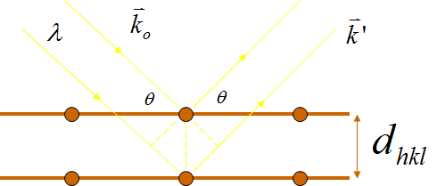
To get a diffraction peak, K has to be a reciprocal lattice vector, but even if K is,
∑ f(r)e^{-ir•K} might still be zero!
Notes:
Structure factor helps give intensity of peaks, and sometimes that can be zero. Technically, SS*
There is some angle dependence on top of this, but we won’t focus on that.

Slide 18
To get a diffraction peak, K has to be a reciprocal lattice vector, but even if K is,
∑ f(r)e^{-ir•K} might still be zero!
The scattered x-ray amplitude is proportional to:
Notes:
Structure factor helps give intensity of peaks, and sometimes that can be zero. Technically, SS*
There is some angle dependence on top of this, but we won’t focus on that.

Slide 19
To get a diffraction peak, K has to be a reciprocal lattice vector, but even if K is,
∑ f(r)e^{-ir•K} might still be zero!
The scattered x-ray amplitude is proportional to:
Can break this sum into a sum over all lattices and a sum over all of the atoms within the basis.
Notes:
Structure factor helps give intensity of peaks, and sometimes that can be zero. Technically, SS*
There is some angle dependence on top of this, but we won’t focus on that.

Slide 20
To get a diffraction peak, K has to be a reciprocal lattice vector, but even if K is,
∑ f(r)e^{-ir•K} might still be zero!
Structure Factor S_{hkl} gives intensity of peaks
The scattered x-ray amplitude is proportional to:
Structure factor
Can break this sum into a sum over all lattices and a sum over all of the atoms within the basis.
Notes:
Structure factor helps give intensity of peaks, and sometimes that can be zero. Technically, SS*
There is some angle dependence on top of this, but we won’t focus on that.

Slide 21
r ○ K
r = n₁ a₁ + n₂ a₂ + n₃ a₃ (real space)

Slide 22
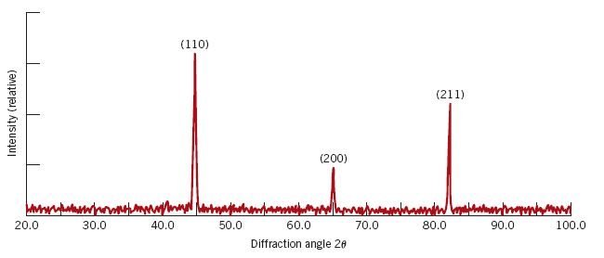

r ○ K
r = n₁ a₁ + n₂ a₂ + n₃ a₃ (real space)
Different h,k,l
Cubic form:
Works for any conventional cubic cell
Where x_{i}, y_{i} and z_{i} are the lattice positions of the atoms in the basis.
h, k and l are the miller indices of different planes in the crystal.

Slide 23
Group: Simple Cubic Lattice
Simplify the structure factor for the simple cubic lattice for a one atom basis. Just let f be a constant.
Where x_{i}, y_{i} and z_{i} are the lattice positions of the atoms in the basis.
Notes:
Sure, you could define the atom to be at a different spot, but then you would still get a phase factor that pulled out and when you take S times its complex conjugate, you’d get the same thing.

Slide 24
Group: Simple Cubic Lattice
Simplify the structure factor for the simple cubic lattice for a one atom basis. Just let f be a constant.
Where x_{i}, y_{i} and z_{i} are the lattice positions of the atoms in the basis.
Notes:
Sure, you could define the atom to be at a different spot, but then you would still get a phase factor that pulled out and when you take S times its complex conjugate, you’d get the same thing.

Slide 25
Group: Simple Cubic Lattice
Simplify the structure factor for the simple cubic lattice for a one atom basis. Just let f be a constant.
Where x_{i}, y_{i} and z_{i} are the lattice positions of the atoms in the basis.
Notes:
Sure, you could define the atom to be at a different spot, but then you would still get a phase factor that pulled out and when you take S times its complex conjugate, you’d get the same thing.

Slide 26
Group: Simple Cubic Lattice
Simplify the structure factor for the simple cubic lattice for a one atom basis. Just let f be a constant.
Where x_{i}, y_{i} and z_{i} are the lattice positions of the atoms in the basis.
Notes:
Sure, you could define the atom to be at a different spot, but then you would still get a phase factor that pulled out and when you take S times its complex conjugate, you’d get the same thing.

Slide 27
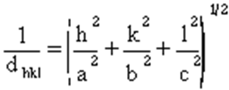
How Do We Determine The Lattice Constant?
For the simple cubic lattice with a one atom basis:
So the x-ray intensity is nonzero for all values of (hkl), subject to the Bragg condition, which can be expressed .
Notes:
Ignoring the angle dependence, it would look like all of the peaks should have the same intensity. In reality, there is angle dependence.
Compare sine squared theta ratios. They should be integer values.
What will be the smallest angle peak? 100

Slide 28
How Do We Determine The Lattice Constant?
For the simple cubic lattice with a one atom basis:
So the x-ray intensity is nonzero for all values of (hkl), subject to the Bragg condition, which can be expressed .
We know for cubic lattices (a=b=c):
Notes:
Ignoring the angle dependence, it would look like all of the peaks should have the same intensity. In reality, there is angle dependence.
Compare sine squared theta ratios. They should be integer values.
What will be the smallest angle peak? 100

Slide 29
How Do We Determine The Lattice Constant?
For the simple cubic lattice with a one atom basis:
So the x-ray intensity is nonzero for all values of (hkl), subject to the Bragg condition, which can be expressed .
We know for cubic lattices (a=b=c):
Substituting and squaring both sides:
Notes:
Ignoring the angle dependence, it would look like all of the peaks should have the same intensity. In reality, there is angle dependence.
Compare sine squared theta ratios. They should be integer values.
What will be the smallest angle peak? 100

Slide 30
How Do We Determine The Lattice Constant?
For the simple cubic lattice with a one atom basis:
So the x-ray intensity is nonzero for all values of (hkl), subject to the Bragg condition, which can be expressed .
We know for cubic lattices (a=b=c):
Substituting and squaring both sides:
Thus, if we know the x-ray wavelength and are given (or can measure) the angles at which each diffraction peak occurs, we can determine a for the lattice! How?
Notes:
Ignoring the angle dependence, it would look like all of the peaks should have the same intensity. In reality, there is angle dependence.
Compare sine squared theta ratios. They should be integer values.
What will be the smallest angle peak? 100

Slide 31
How Do We Determine The Lattice Constant?
For the simple cubic lattice with a one atom basis:
So the x-ray intensity is nonzero for all values of (hkl), subject to the Bragg condition, which can be expressed .
We know for cubic lattices (a=b=c):
Substituting and squaring both sides:
Thus, if we know the x-ray wavelength and are given (or can measure) the angles at which each diffraction peak occurs, we can determine a for the lattice! How?
Notes:
Ignoring the angle dependence, it would look like all of the peaks should have the same intensity. In reality, there is angle dependence.
Compare sine squared theta ratios. They should be integer values.
What will be the smallest angle peak? 100

Slide 32
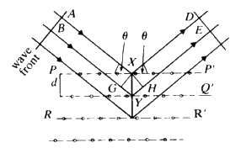
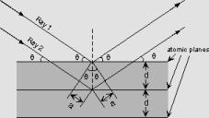
Missing Spots in the Diffraction Pattern
In some lattices, the arrangement and spacing of planes produces diffractions from planes that are always exactly 180º out of phase causing a phenomenon called extinction.
Can you think of an example?
=λ/2

Slide 33
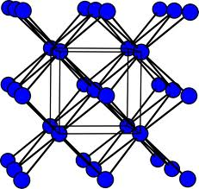

Missing Spots in the Diffraction Pattern
In some lattices, the arrangement and spacing of planes produces diffractions from planes that are always exactly 180º out of phase causing a phenomenon called extinction.
For the BCC lattice the (100) planes are interweaved with an equivalent set at the halfway position, giving a reflection exactly out of phase, which exactly cancel the signal.
Can you think of an example?

Slide 34
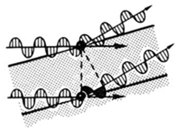
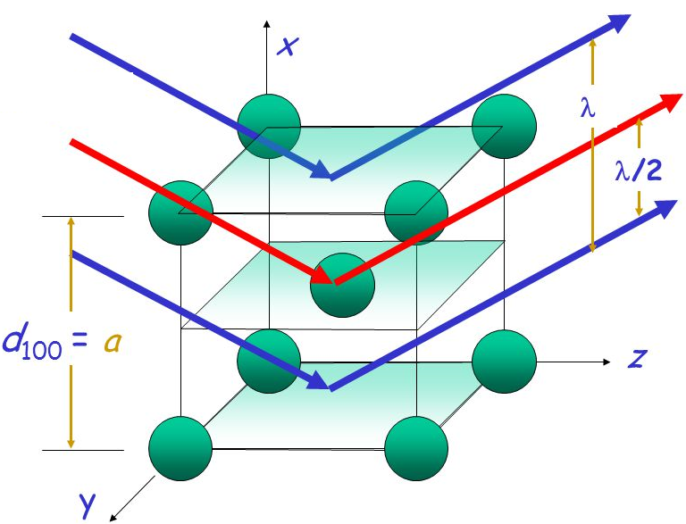
Extinction in BCC
(001)
Notes:
Also 110 and 011

Slide 35
Extinction in BCC
(-101)
(001)
What about the 101 family of planes?
Notes:
Also 110 and 011

Slide 36
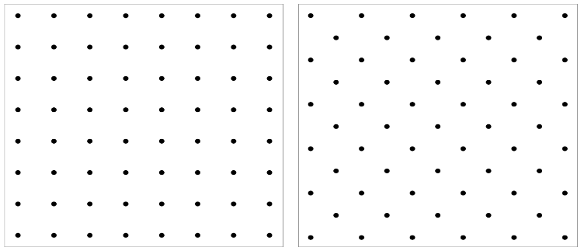
Extinction in BCC
Let’s see how this shows up in the structure factor
(-101)
(001)
What about the 101 family of planes?
Notes:
Also 110 and 011

Slide 37
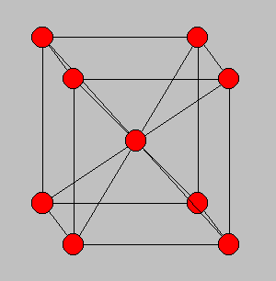
The Structure Factor of BCC
What values of hkl do not have diffraction peaks?
Notes:
We COULD do it this other way with the primitive lattice vectors. The math would get a little worse, but you get the same result. This is where the conventional cell is of great value.

Slide 38
Group: The Structure Factor of BCC
What values of hkl do not have diffraction peaks?
Analysis of more than one lattice point per conventional unit cell
E.g: bcc and fcc lattices
Notes:
We COULD do it this other way with the primitive lattice vectors. The math would get a little worse, but you get the same result. This is where the conventional cell is of great value.

Slide 39
Group: The Structure Factor of BCC
What values of hkl do not have diffraction peaks?
Analysis of more than one lattice point per conventional unit cell
E.g: bcc and fcc lattices
bcc conventional lattice has two atoms per unit cell located at
r₁ = (0,0,0) and r₂ = (1/2,1/2,1/2)
Notes:
We COULD do it this other way with the primitive lattice vectors. The math would get a little worse, but you get the same result. This is where the conventional cell is of great value.

Slide 40
Group: Find the structure factor for BCC. Under what h,k,l is it non-zero?
Notes:
Euler's identity
Does the minus sign matter? No, you just have (-1)^(-1) or 1/-1 which is still -1

Slide 41
Group: Find the structure factor for BCC. Under what h,k,l is it non-zero?
Notes:
Euler's identity
Does the minus sign matter? No, you just have (-1)^(-1) or 1/-1 which is still -1

Slide 42
Group: Find the structure factor for BCC. Under what h,k,l is it non-zero?
Notes:
Euler's identity
Does the minus sign matter? No, you just have (-1)^(-1) or 1/-1 which is still -1

Slide 43
Group: Find the structure factor for BCC. Under what h,k,l is it non-zero?
Notes:
Euler's identity
Does the minus sign matter? No, you just have (-1)^(-1) or 1/-1 which is still -1

Slide 44
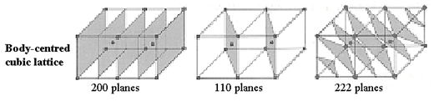
Group: Find the structure factor for BCC. Under what h,k,l is it non-zero?
Notes:
Euler's identity
Does the minus sign matter? No, you just have (-1)^(-1) or 1/-1 which is still -1

Slide 45

Visualizing the structure factor for BCC
Allowed low order reflections are:
  110, 200, 112, 220, 310, 222, 321, 400, 330, 411, 420 …
  Draw lowest on this cube ->
Forbidden reflections are:
  100, 111, 210…
  Due to identical plane of atoms halfway between causes destructive interference
Real bcc lattice has an fcc reciprocal lattice (this is a good trick for remembering the rule)
002
022
112
011
202
121
000
101
020
211
110
200
220
This kind of argument leads to rules for identifying the lattice symmetry from "missing" reflections.

Slide 46
How to determine lattice parameter this time?
For a bcc lattice with a one atom basis, the x-ray intensity is nonzero for all planes (hkl), subject to the Bragg condition, except for the planes where h+k+l is odd. Thus, diffraction peaks will be observed for the following planes:
(100) (110) (111) (200) (210) (211) (220) (221) (300) …
Notes:
If you don’t know because you don’t know what structure. You have to guess and find ratios until you get something that makes sense. (I have an example that does that but it’s not short. I don’t normally have time for it.)

Slide 47
How to determine lattice parameter this time?
For a bcc lattice with a one atom basis, the x-ray intensity is nonzero for all planes (hkl), subject to the Bragg condition, except for the planes where h+k+l is odd. Thus, diffraction peaks will be observed for the following planes:
(100) (110) (111) (200) (210) (211) (220) (221) (300) …
Just as before, if we are given or can measure the angles at which each diffraction peak occurs, we can graphically determine a for the lattice!
Notes:
If you don’t know because you don’t know what structure. You have to guess and find ratios until you get something that makes sense. (I have an example that does that but it’s not short. I don’t normally have time for it.)

Slide 48
How to determine lattice parameter this time?
For a bcc lattice with a one atom basis, the x-ray intensity is nonzero for all planes (hkl), subject to the Bragg condition, except for the planes where h+k+l is odd. Thus, diffraction peaks will be observed for the following planes:
(100) (110) (111) (200) (210) (211) (220) (221) (300) …
Just as before, if we are given or can measure the angles at which each diffraction peak occurs, we can graphically determine a for the lattice!
A similar analysis can be done for a crystal with the fcc lattice with a one atom basis. For materials with more than one of the same atom type per basis in a cubic lattice, the rules for the structure factor can be modified.
Notes:
If you don’t know because you don’t know what structure. You have to guess and find ratios until you get something that makes sense. (I have an example that does that but it’s not short. I don’t normally have time for it.)

Slide 49
How to determine lattice parameter this time?
For a bcc lattice with a one atom basis, the x-ray intensity is nonzero for all planes (hkl), subject to the Bragg condition, except for the planes where h+k+l is odd. Thus, diffraction peaks will be observed for the following planes:
(100) (110) (111) (200) (210) (211) (220) (221) (300) …
Just as before, if we are given or can measure the angles at which each diffraction peak occurs, we can graphically determine a for the lattice!
What if you don’t know the h k l values?
A similar analysis can be done for a crystal with the fcc lattice with a one atom basis. For materials with more than one of the same atom type per basis in a cubic lattice, the rules for the structure factor can be modified.
Notes:
If you don’t know because you don’t know what structure. You have to guess and find ratios until you get something that makes sense. (I have an example that does that but it’s not short. I don’t normally have time for it. You’ll get practice on this in the homework.)

